Slide 1
Light-sheet microscopy
Theresa Swayne
Pon lab meeting
February 19, 2019

Slide 2
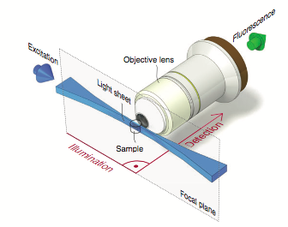
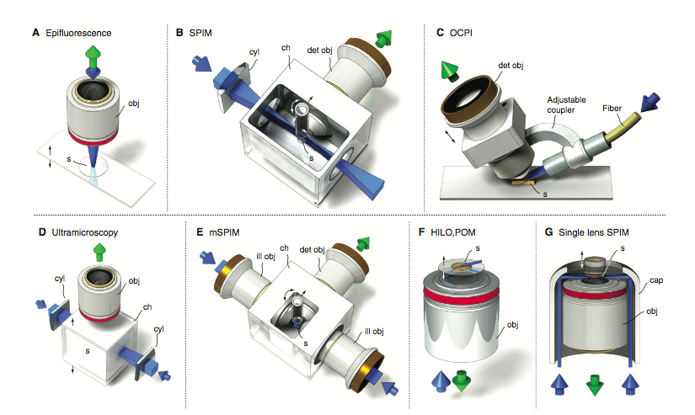
LSFM / SPIM
Matching excitation and imaging volumes
Greater efficiency (time and photons)
Instrument is designed around the sample
Huisken 2009
Notes:
Goal: understand basic principles of lsfm, different kinds of instruments and what they are good for, drawbacks, and potential for use

Slide 3
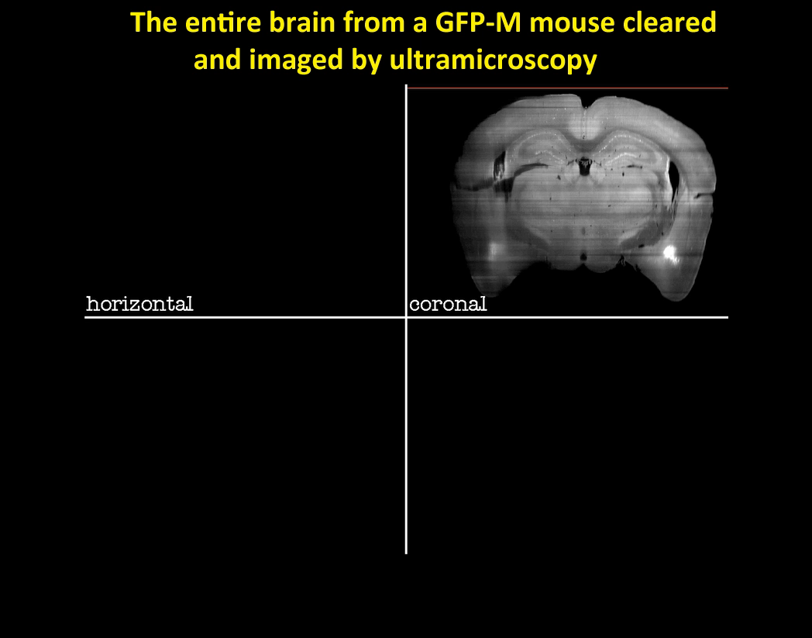
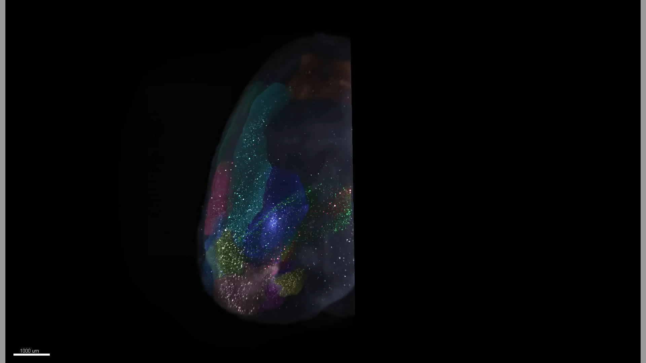
Applications of LSFM
LaVision ultramicroscope
Custom ultramicroscope
Ertürk 2012, Fu 2016
Notes:
Mouse expressing human pathogenic tau, 34 months old, cleared and stained for Tau

Slide 4
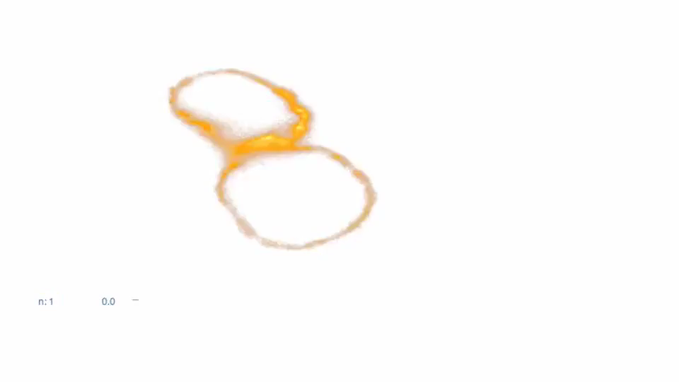
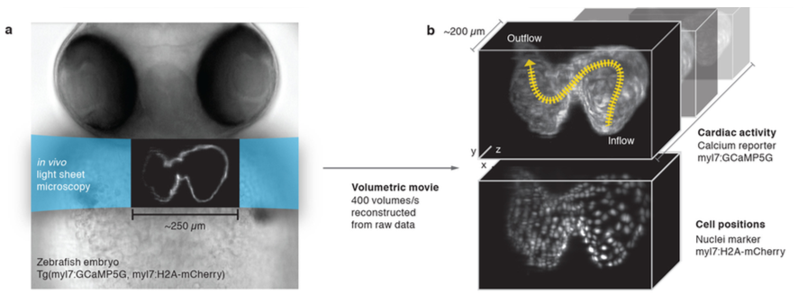
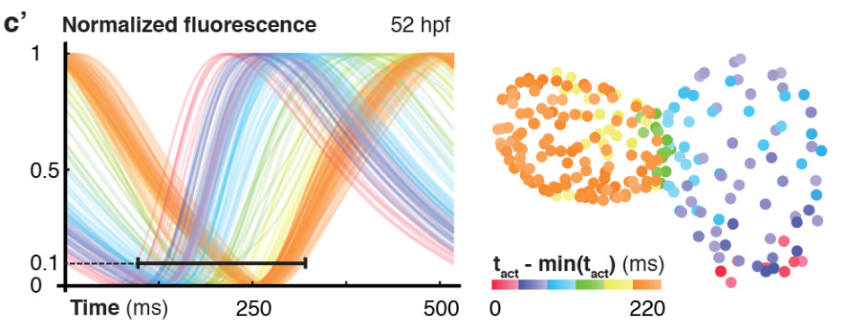
Applications of LSFM
Custom SPIM
Activator cells
Weber 2017

Slide 5
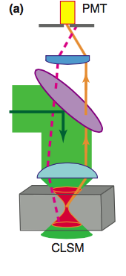
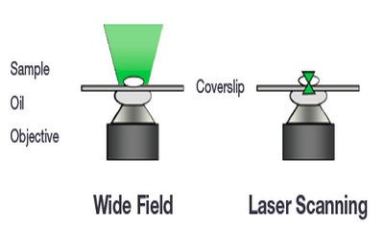
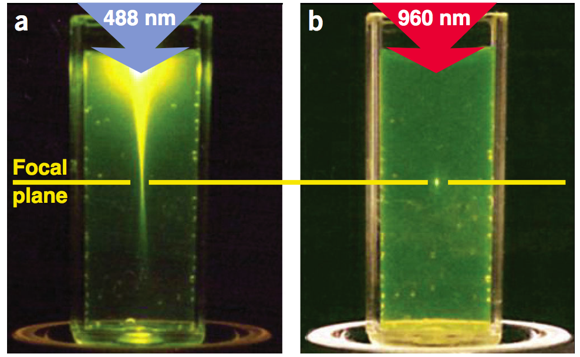
Optical sectioning is achieved by limiting either excitation or detection
Least damaging
1-photon
2-photon
Z
Illumination | full depth | full depth | point
Detection | full depth | point | point
Andor; Fischer 2011; Zipfel 2003
Notes:
To get started understanding why light-sheet imaging is special, it might help to review how different microscopes are designed to solve the problem of viewing a 3D object where one plane is in focus, but there may be signal coming from out-of-focus planes as well.
When Excitation matches detection in x,y, and z, that’s the most efficient way to use the photons you have. That’s one reason why 2-photon excels with live samples.

Slide 6
Optical sectioning can slow down acquisition
1-photon
2-photon
XY
Illumination | field | point | point
Detection | field | point | point
Andor; Fischer 2011; Zipfel 2003
Notes:
You might notice that the optical sectioning in both 1-photon and 2-photon confocal imaging depends on point excitation. This has one huge drawback. It slows down acquisition considerably.
For a real-word example, a typical pixel dwell time on our scanning confocal might be 2.4 µs. To capture a 1024 x 1024 image would therefore take 2.5 s, about 10 x slower than a typical wide-field image.
Plus, to get a measurable amount of fluorescence in 2.5 µs requires much higher intensity excitation than if you have 250 ms to collect the photons. So this form of optical sectioning can be very damaging to fragile or live samples.

Slide 7
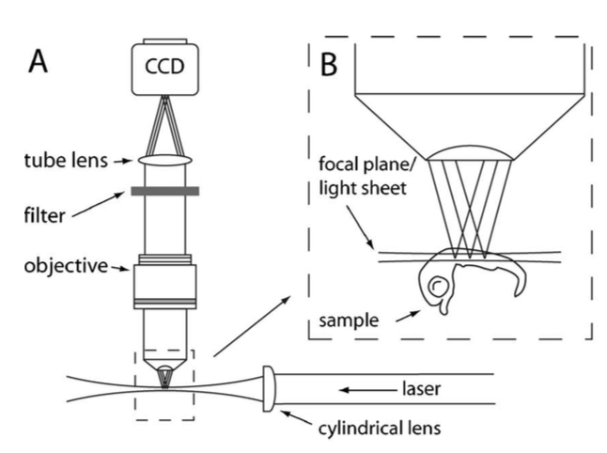
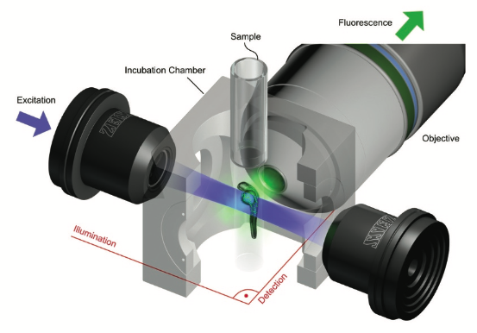
LSFM: Excitation and detection of the whole plane
Zeiss; Greger 2006
Notes:
The key insight of LSFM is to make the excitation match the detection volume, but to do it with a PLANE instead of a point.
The result is that it is both faster because you detect points rather than planes, and gentler
Allen mouse brain atlas rendered on scalablebrainatlas.incf.org/

Slide 8
LSFM: Excitation and detection of the whole plane
Faster
Whole-plane detection
Gentler
No off-target excitation
Lower illumination intensity (ms, not µs exposure)
Zeiss
Notes:
The key insight of LSFM is to make the excitation match the detection volume, but to do it with a PLANE instead of a point.
Allen mouse brain atlas rendered on scalablebrainatlas.incf.org/

Slide 9
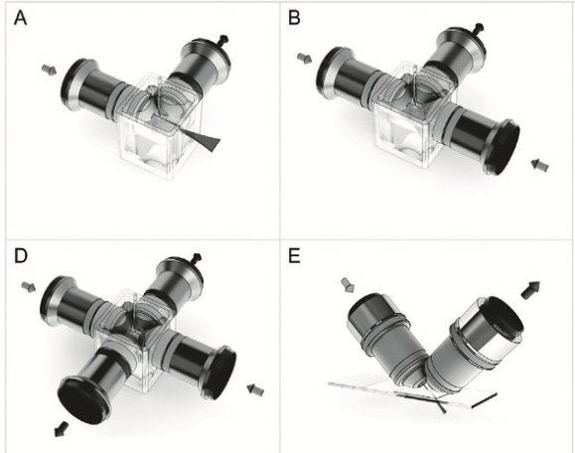
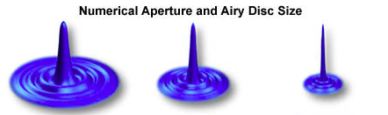
The classical LSFM light path limits resolution
Orthogonal illumination and detection
Long working distance
Lower numerical aperture & resolution
Zeiss/Microscopy & Analysis 2017; Olympus
Olympus
Notes:
So why isn’t everyone doing this? Because there are several trade-offs that need to be made in this design. This dramatically different light path has 2 big consequences.

Slide 10
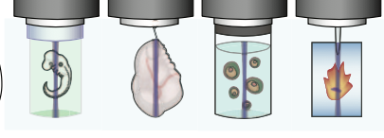
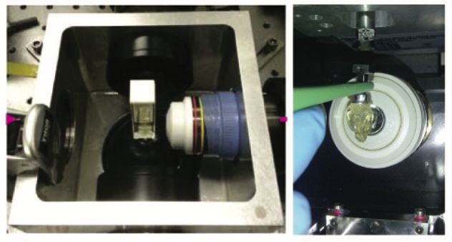
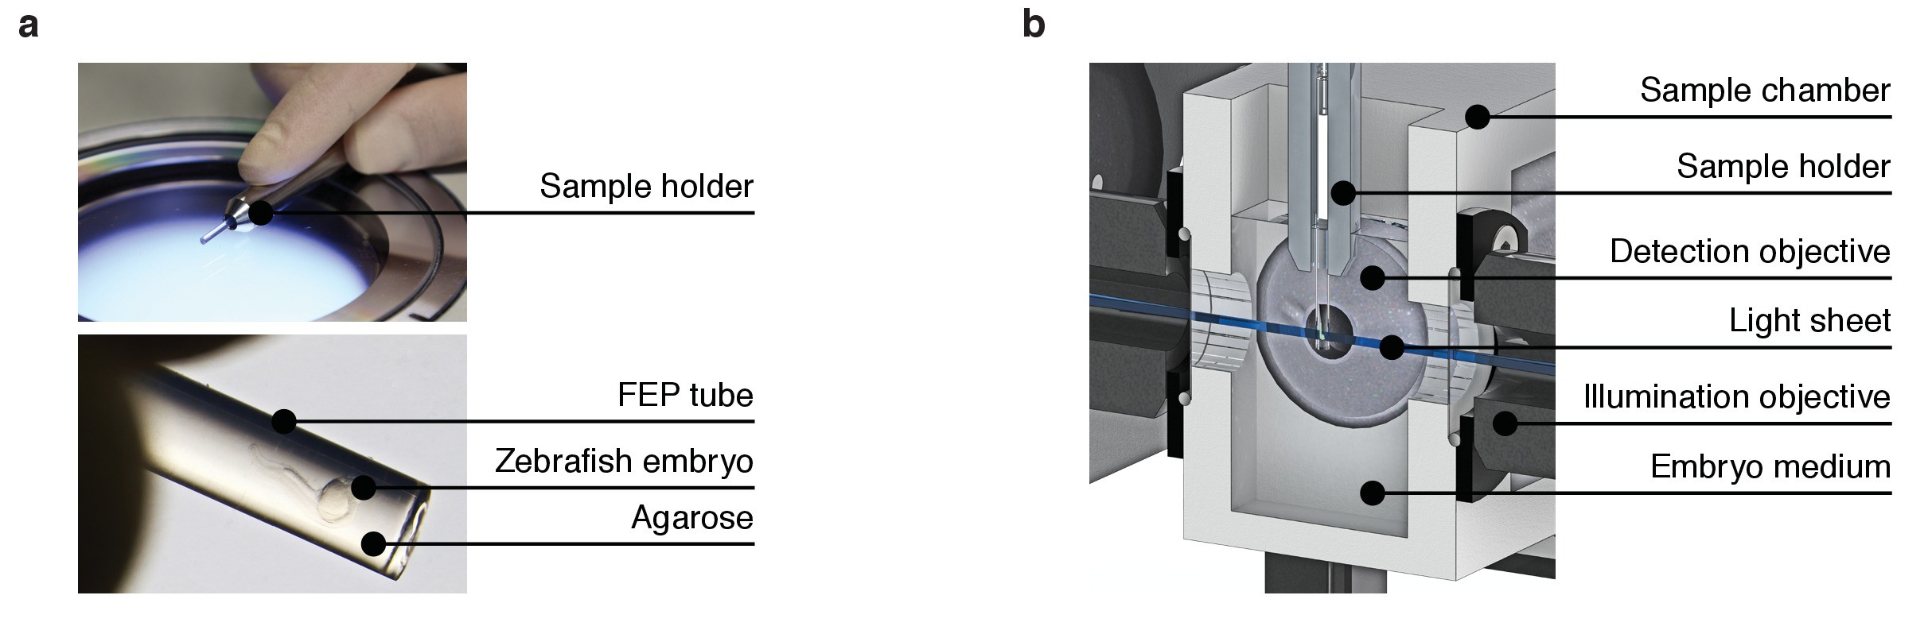
The classical LSFM light path constrains sample mounting
Orthogonal illumination and detection
Sample must be accessible from 2 directions
(at least 1 with immersion)
Special sample preparation needed
Zeiss/Microscopy & Analysis 2017; Tomer 2014; Reynaud 2015; Weber 2017
Olympus
Notes:
Embedded, hanging “clipped”, floating, “flat” (hanging coverslip)

Slide 11
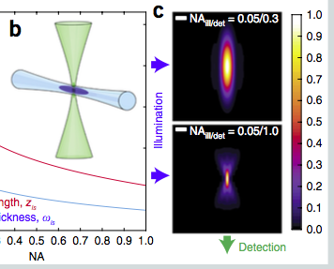
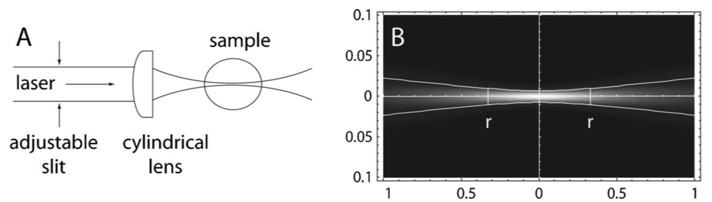
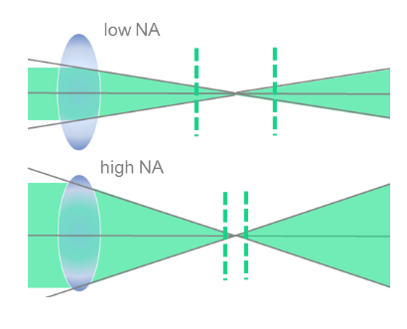
Optimizing resolution of LSFM: constraints on NA
Detection PSF
Illumination PSF
System PSF
Higher detection NA
z
Higher illumination NA
sheet divergence
smaller effective field of view
Zeiss/Microscopy & Analysis 2017; Power 2017; Greger 2006; LaVision BioTec
Notes:
So let’s start with the question of resolution.
Since both the illumination and detection optics have to reach the sample, neither of them can be very close to the sample.
The lenses you’re using most often in the lab have a working distance of about 100 µm.
We’re not getting there with this system. And we know that working distance is inversely related to NA. So what resolution can we achieve with light-sheet?
System PSF = product of illumination and detection PSFs. The smaller the PSF the better the resolving power.
Typical detection NAs for cellular level resolution are 0.8-1.0
With the divergence the field of view becomes limiting. Typical values for the illumination NA are around 0.1-0.3. This gives a sheet thickness of 1-4 µm.

Slide 12
Optimizing resolution of LSFM: constraints on NA
Detection PSF
Illumination PSF
System PSF
Limits on NA
Working distance: lens placement
Field of view: sheet divergence
Approximate resolution for NA 0.3_{ill}/1.0_{det}:
~0.4 µm lateral, ~1 µm axial
Zeiss/Microscopy & Analysis 2017; Power 2017; LaVision
Notes:
So, the lens placement and the diffraction of the light sheet away from the plane both limit the resolution in classical light sheet imaging. You can still however get some subcellular-level resolution.

Slide 13
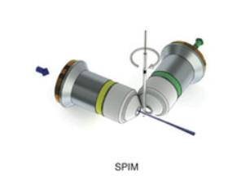
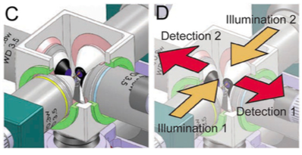
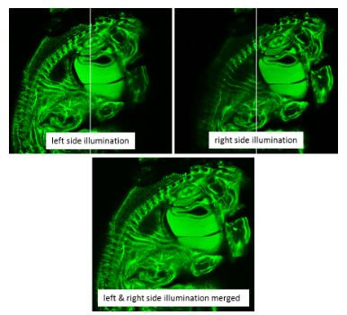
Optimizing LSFM: Sample rotation and multiview imaging for better axial resolution
Isotropic resolution possible, after registration and reconstruction
Bidirectional illumination
Multiview detection
Sample rotation
Huisken lab; Höckendorf 2012; LaVision
Notes:
You might have noticed that with the low illumination NA, the axial or z resolution is not as good as the lateral resolution. This is familiar to us because it’s the usual case in optical imaging. However, the unique layout of the light sheet microscope suggests a method to improve this.
By rotating the sample, you can make the z axis into the new xy axis, and in this way you can get isotropic resolution
Rotation takes time, so to speed up the process, just add more optics.

Slide 14
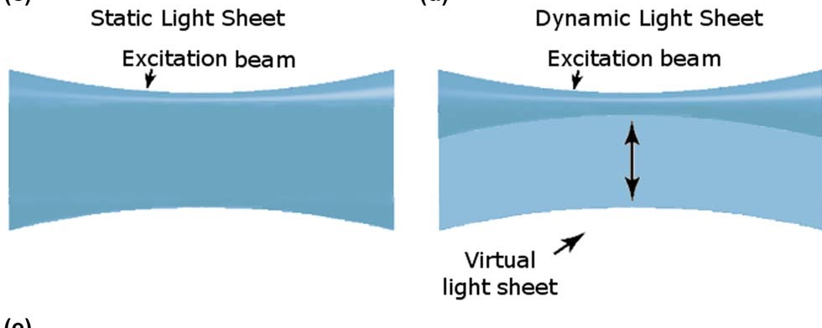
Optimizing LSFM: Scanned illumination and line detection
FOV wider, more uniform
Less scattering
Higher laser intensity
Slower
Line sweeps across sample: virtual sheet
Detection: line by line on CMOS/CCD
Can be combined with confocal slit detection
Zagato 2018
Notes:
With a scanned virtual light sheet the illumination is more uniform across the sample so it’s better for quantitative analysis

Slide 15
Summary of trade-offs in light-sheet imaging
Constraints on spatial resolution
Field of view
Sample size
Lens shape
Constraints on sample mounting
Transparency from at least 2 sides
(Rotation)
Constraints on time resolution
Sample rotation
Number of z sections needed
Scanned vs. plane illumination
Photodamage
Resolution
Speed
Sensitivity

Slide 16
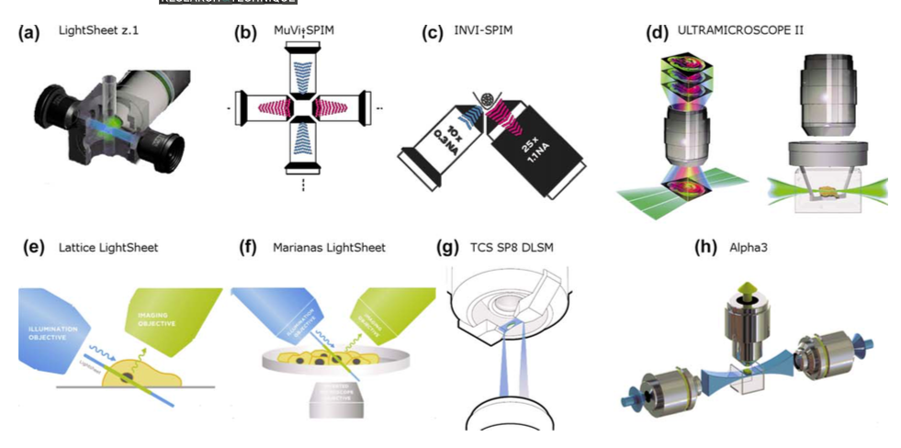
Commercial light-sheet systems
Princeton
Zuckerman, Rockefeller
Zagato 2018
Notes:
Choosing an LSFM depends on sample, detail needed, and how much time you want to put in to keeping it in working order.
Zeiss Z.1 (Princeton)
Leica DLS
LaVision UltraMicroscope II (zmbbi, rock, sinai)
Bruker MuVi SPIM and InVi SPIM(yale, Princeton)

Slide 17
Commercial light-sheet systems
Sample size
~30–300 µm
Up to 3 x 3 x 1.5 cm
Zagato 2018
Notes:
Choosing an LSFM depends on sample, detail needed, and how much time you want to put in to keeping it in working order.
Zeiss Z.1 (Princeton)
Leica DLS
LaVision UltraMicroscope II (zmbbi, rock, sinai)
Bruker MuVi SPIM and InVi SPIM(yale, Princeton)

Slide 18
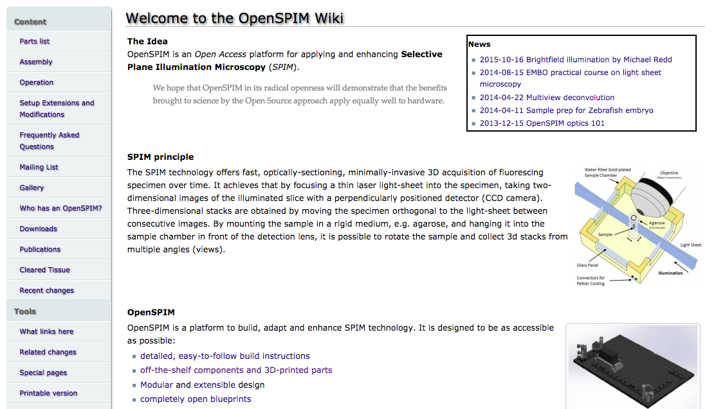
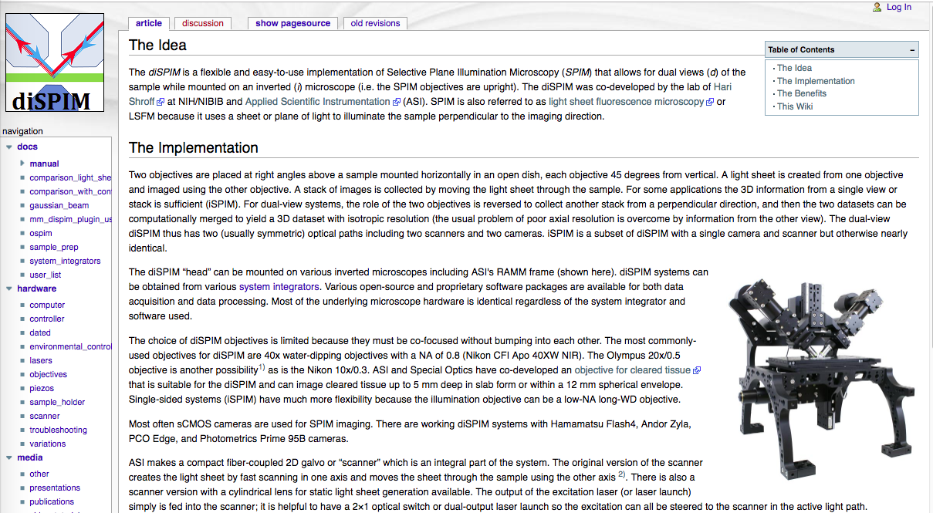
No main patent: many freely available designs

Slide 19
Summary: Light-sheet imaging is a fundamentally different microscope design
Full-plane illumination and detection make light-sheet imaging fast and gentle.
The orthogonal optics require special sample mounting.
Some LSFMs can image very large samples (up to a few cm) if they are clear enough.
LSFM can be excellent for cleared tissue and transparent embryos
Notes:
you can only do a subset of all “light-sheet” applications with a single system. (Possibly comparing with “Gels” – which includes 2D, agarose, acrylamide, 5% 15% etc. One gel cannot do everything)

Slide 20
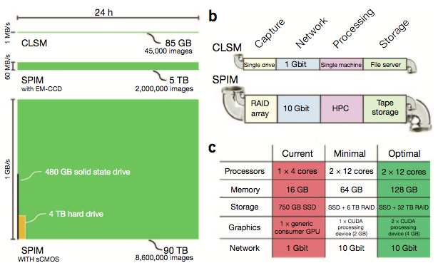
Future directions: Light-sheet imaging could be useful for many labs, but is rare in core facilities
Adoption in multi-user facilities has been slow so far
No single system works for all (or even most) samples & applications
Few major companies have entered the field, most products are new
Computing demands are significant
Highly motivated labs may build their own
It’s a good core investment if:
Enough users have appropriate applications
Users can adapt mounting methods
Computing power is available
Notes:
you can only do a subset of all “light-sheet” applications with a single system. (Possibly comparing with “Gels” – which includes 2D, agarose, acrylamide, 5% 15% etc. One gel cannot do everything)

Slide 21
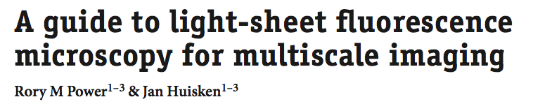
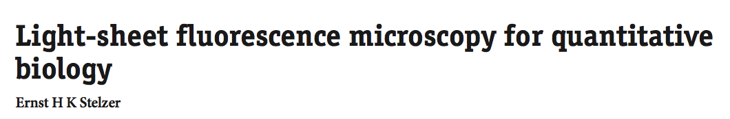
Further reading
Nature Methods, 2017, DOI: 10.1038/nmeth.4224
Nature Methods, 2015, DOI: 10.1038/nmeth.3219

